Slide 1

Car Rental System
Name : Solanki Bharatsinh (21012011140)
Umretiya Tushar (2101211152)
Bhalodiya Maulik (21012011004)
Team_Id: 17
Guided By : Ketan J Sarvakar

Slide 2
Overview of Project
The Car Rental System is a web-based application designed to manage the process of renting cars efficiently. It allows users to search for available cars, make reservations, and process payments online. Admins manage the car inventory, review bookings, and maintain the system’s operations. The system aims to simplify car rental services for both customers and administrators by offering an intuitive, secure, and efficient interface.

Slide 3
Objective
The objective of the Car Rental System is to centralize and provide accessible information about available vehicles, rental policies, and payment options. It aims to empower users by offering a streamlined platform for booking cars, managing rentals, and tracking reservations, ultimately leading to enhanced customer convenience, improved operational efficiency, and increased business growth.

Slide 4
Functional Requirements
User Registration
Input:
  User provides:
    Full Name
    Email Address (used as username)
    Mobile Number
    Password

Slide 5
Functional Requirements
Process:
  Validation:
    Check if the Email is unique and not already registered.
    Validate the email address format.
    Ensure the password meets security criteria (e.g., length, complexity).
  Database Operations:
    Hash the password for secure storage.

Slide 6
Functional Requirements
Output:
  Success:
    Display a confirmation message that registration was successful.
    Redirect the user to the login page or homepage.
  Failure:
    Display an error message indicating issues (e.g., Email already in use, invalid email format).
    Prompt the user to correct and resubmit the information.

Slide 7
Functional Requirements
Search Car
Input:
  User provides search criteria:
    Car Brand
    Car Model
    Rental Location
    Rental Dates
    Car Type (e.g., sedan, SUV)

Slide 8
Functional Requirements
Process:
  Search Execution:
    Query the database for cars matching the search criteria.
    Filter results based on availability and other parameters.
Output:
  Success:
    Display a list of available cars that match the search criteria, including details like car model, brand, rental rate, and availability.

Slide 9
Functional Requirements
  Failure:
    Display a message indicating no cars are available that match the search criteria.
    Offer options to modify search criteria or check for other locations/dates.

Slide 10
Non Functional Requirements
Performance Requirements: Search results for available cars should be returned in less than 3 seconds.
The booking confirmation process, including payment validation, should complete in under 5 seconds.
Usability: The system should be accessible from different devices, including desktops, tablets, and smartphones (responsive design).
Provide clear and concise error messages and tooltips to guide users through the reservation process.

Slide 11
Non Functional Requirements
Maintainability: Modular architecture for easy updates, with thorough documentation and automated testing.
Security Requirements: Passwords must be hashed using secure algorithms The system should log failed login attempts and enforce account lockout after 5 consecutive failed attempts.
Scalability: The system should be able to scale horizontally by adding more servers or cloud resources to handle increased user load. The system should accommodate expansion to multiple locations.

Slide 12
Technological Stack
Frontend (User Interface)
HTML5: For the structure and layout of web pages.
CSS3: For styling the UI, making it responsive and visually appealing (consider using Bootstrap for responsiveness).
JavaScript: For client-side interactivity and functionality, such as form validation and dynamic content.
AJAX (Asynchronous JavaScript and XML): For making asynchronous requests to the server without reloading the page.

Slide 13
Technological Stack
Backend (Server-Side Logic)
PHP: For server-side scripting, handling business logic, processing requests, managing user sessions, and integrating with the database.
Database (Data Storage)
MySQL: Use it for creating relational database tables to manage users, cars, bookings, and payments efficiently.
Use phpMyAdmin for easy database management and queries.

Slide 14
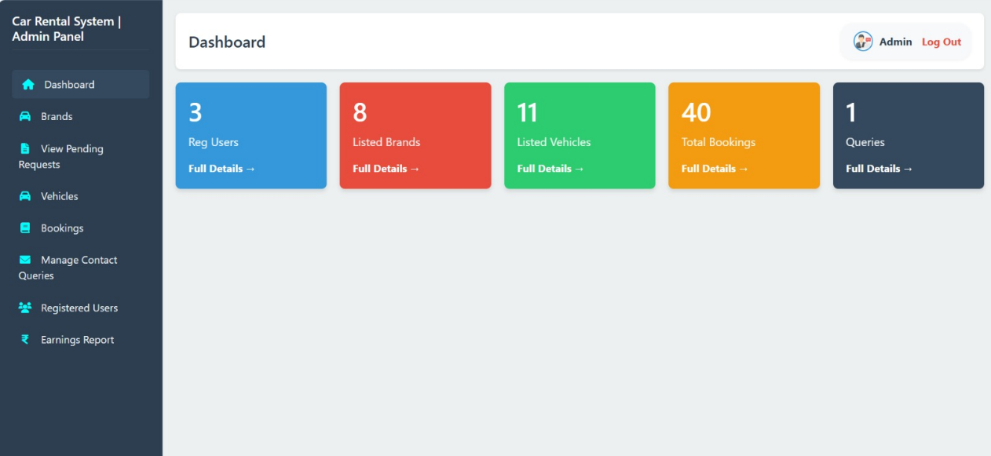
Admin Dashboard page

Slide 15
Admin Dashboard Page Description
The admin dashboard for a car rental system provides an overview of key metrics, including listed vehicles, bookings, brands, testimonials, and queries. It allows for easy navigation and management of various aspects of the system, such as brands, vehicles, bookings, and user information.

Slide 16
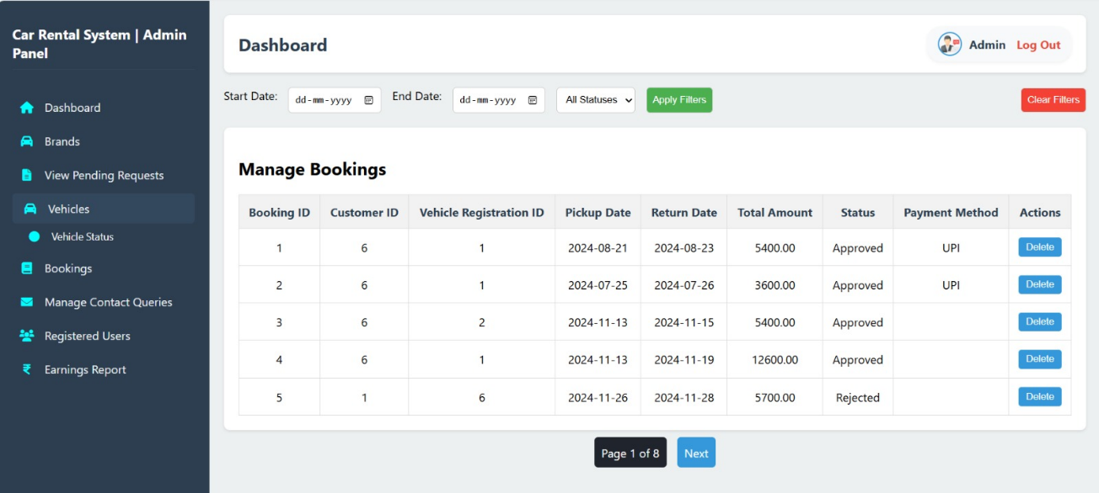
Admin Booking page

Slide 17
Admin Booking Page Description
The admin booking page within the car rental system allows for the management of customer bookings. It displays a list of existing bookings, including customer information, vehicle details, booking dates, status, and posting dates. Administrators can view booking details and potentially take actions such as confirming or canceling bookings.

Slide 18
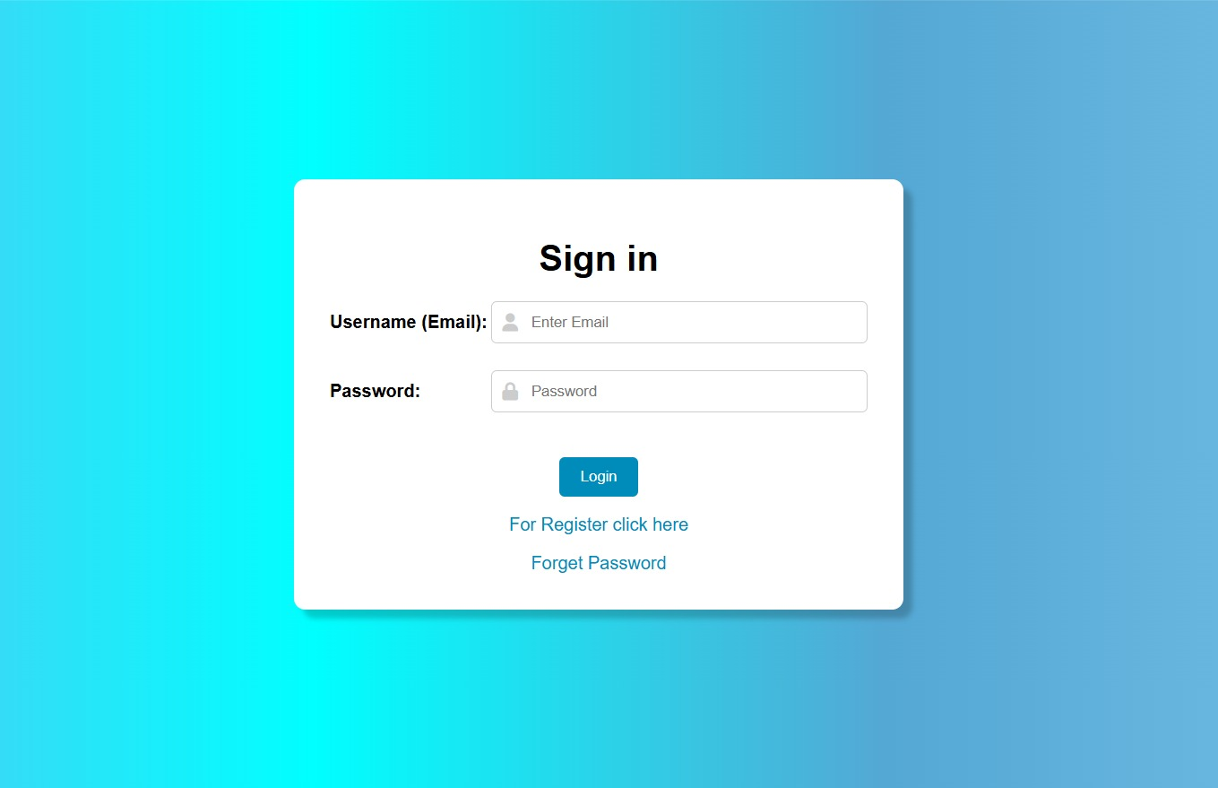
User Sign-In Page

Slide 19
User Sign-In Page Description
This page presents a login interface with options, after complete login user will redirect to home page, for not registered users. Users can click to “register now” link to complete register process.

Slide 20
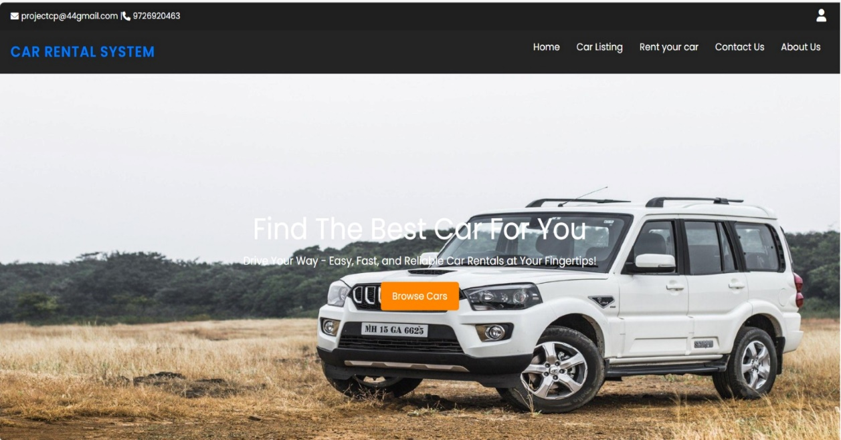
Home Page

Slide 21
Home Page Description
This HTML page displays a welcoming message alongside a car image, inviting visitors to explore rental options. The navigation bar offers easy access to key sections such as car brands, car listings, FAQs, and contact information.

Slide 22
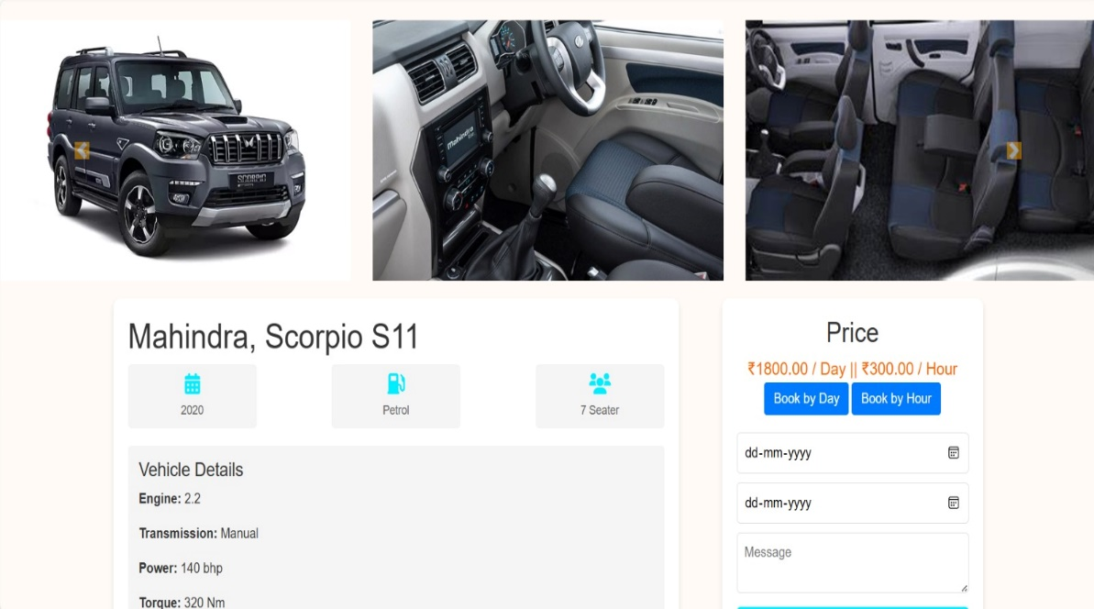
Book Car Page

Slide 23
Book Car Page Description
The Book Car Page Provide Different Car For Customers. The page design is clean and structured, showcasing important details about the car and allowing the user to book the vehicle.

Slide 24
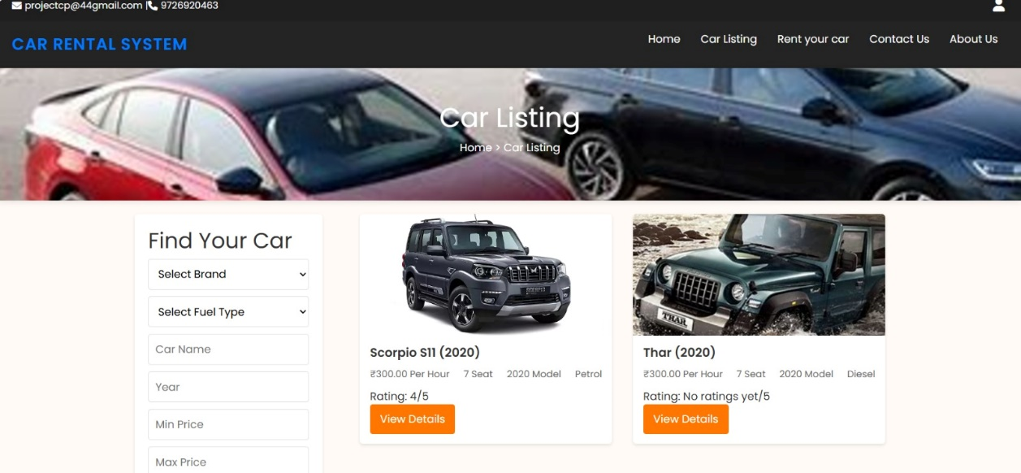
Car Listing

Slide 25
Car Listing Page Description
The Car Listing page showcases available rental vehicles with images, key details like fuel type, seating capacity, and price per day. A clean, organized layout allows easy comparison of features such as engine, transmission, and mileage. Filters enable quick browsing, ensuring a seamless car selection experience for users.

Slide 26
Thank you!

